Slide 1
Flight Gear Controller
Roe Tamir and Itay Gradenwits

Slide 2
Intro
We created an android app to control flight simulator using the app Flight Gear. The app enable to connect to a flight gear server which running on a computer at your local network, and control the flight simulator using seek bars and a joystick.

Slide 3
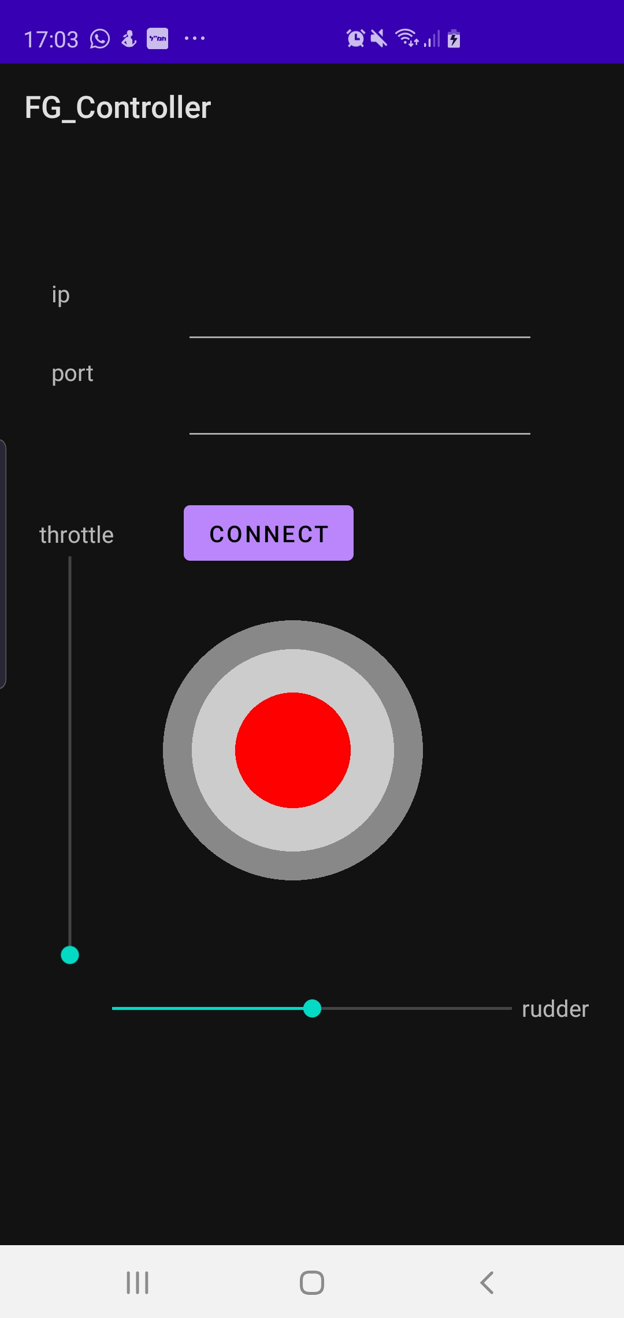
MVVM Architecure - The View
The view is the part in the code that responsible of the graphic experience of the user. In our project in the package view you'll find 2 classes: Joystick and MainActivity . Those classes responsible of the code behind of the view. Joystick is a custom view controller we wrote, and MainActivity is the main class of the app. In Main Activity we hold reference to a ViewModel object, just like in the MVVM Architecture. We'll bind data from the graphic controllers we have to the viewModel fields. The xml file activity_main.xml is the file responsible of the graphic part of the view. It set the attributes of the graphic controllers which set the way the screen looks.

Slide 4
MVVM Architecture- The view Model
The view_model package contains the class ViewModel the role of this class is to be kind of a pipe between the model and the view. Therfore we need to bind data from the view to the viewModel fields and call the model functionality while necessary. The viewModel hold a reference to a model object and uses it while necessary.

Slide 5
MVVM Architecture- The Model
The model package contains the class Model. This class responsible to connect the FG server and send it data. The connection and communication must be in a separate thread to not stuck the UI. Therefore we hold a reference to a threadPool object that manage the functionalliy in a seperate thread.

